Slide 1


Slide 2
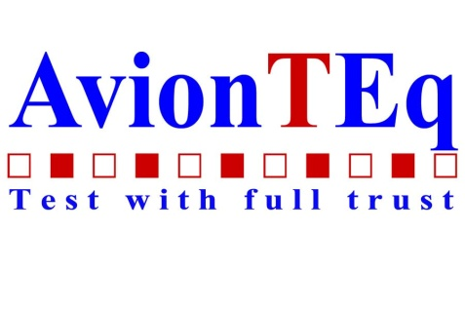

MyTEq provides organization and answers
Equipment availability and location
Equipment calibration status
Calibration certificate
…FAA is here!
Calibration due date
Equipment manuals
Job specific supporting documents
Pictures and notes

Slide 3
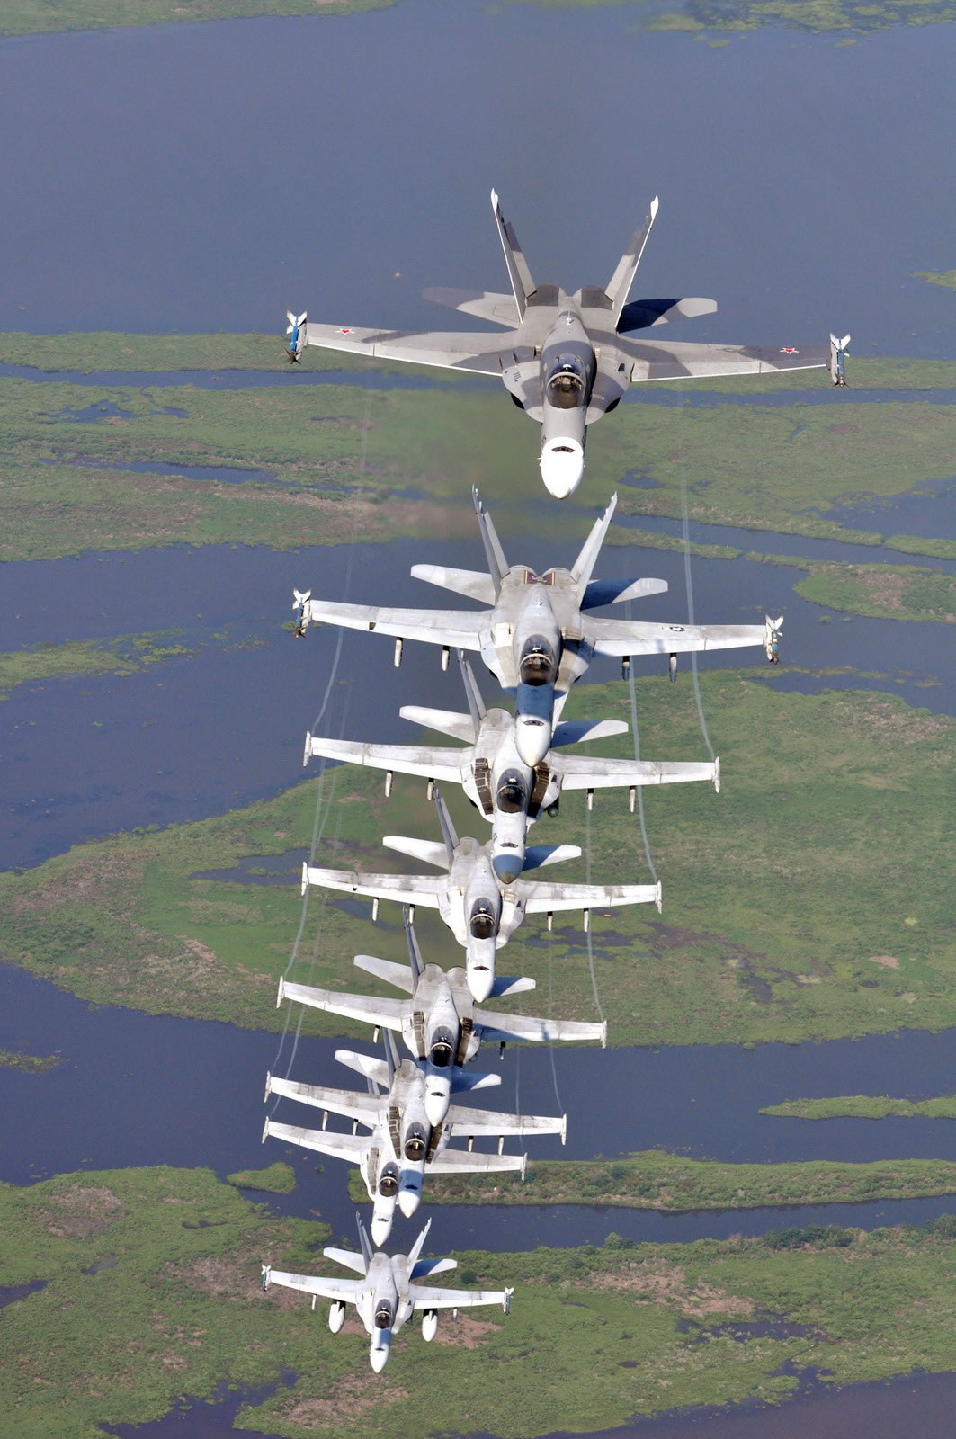
MyTEq Increases efficiency and performance
Available anywhere in the world. using a PC or smart phone
Better control and management of equipment and tools
Monitor, receive reminders and plan for calibration of equipment
Track the equipment, identify the person in charge and locate
Provide additional instruction, information and notes

Slide 4
Ease of use. Global accessibility.
Easy-to-use interface that makes it simple to upload your equipment information
MyTEq provides quick access to the following information from any location
Part Number
Revision
Description
Model Number
Alt Part Number
Modifications
Quantity
Asset Type
Condition
Serial Number
Asset ID
Location
Date Received
Person In Charge
PIC Contact No
Last Calib Date
Calib Due Date
Notes/Instructions
Manuals
Certificates
pictures

Slide 5
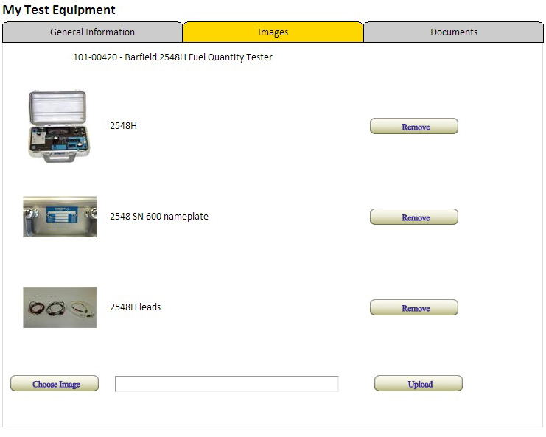
Picture This…
You can upload up to 3 pictures for each piece of equipment.
Illustrate how the equipment should be set up
Show display readouts
Show buttons and switches
Show accessories, cables, etc

Slide 6

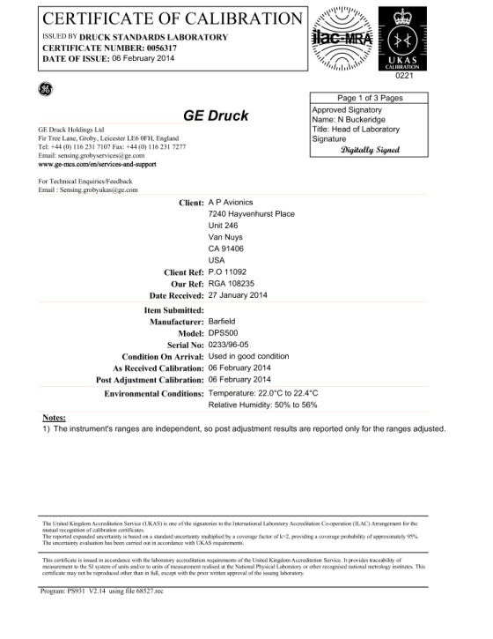
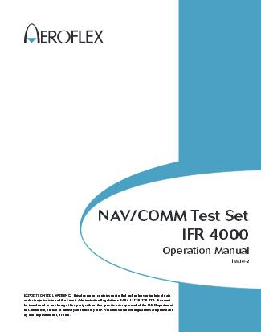
Manuals, Certificates and more
MyTEq allows you to upload and make accessible:
Specification sheets
Operations manual
Calibration certificates
Reference material
Forms and any other helpful documents for operation of the equipment, and compliance with policies and regulations.

Slide 7

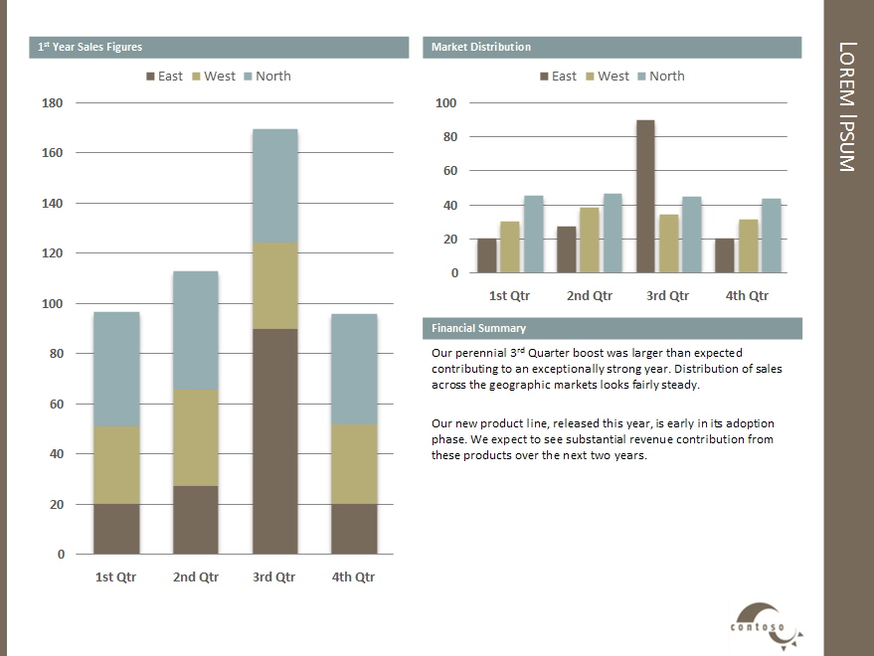
More to come
AvionTEq welcomes your feedback, comments and suggestions to help make MyTEq the most useful and user friendly tool of its kind. Some of the additional features we are working on include:
MyTEq mobile app for iPhone, and Android smart phones.
Calibration lab management
Calibration / repair order processing
Reports and statistics

Slide 8

MyTEq advantage
Boost efficiency and productivity
Improve quality control and compliance
Lower the risk of mistakes
Avoid costly delays and errors
Increase your bottom line and your piece of mind
Sign up this week for FREE!

